Slide 1
2021 Albuquerque Craigslist Used Car Analysis
Charles Mbakop

Slide 2
CONTENTS
Introduction
Popular Characteristics
Popular Brands
Summary
Recommendations

Slide 3
INTRODUCTION
An analysis of Albuquerque, New Mexico Craigslist car listings from April 19 to May 4th, 2021, looking at the most prevalent features among popular cars including condition, fuel type and drive type, and consumer brand favoritism and model year preferences.

Slide 4
Important Definitions
Manufacturer: The company that produced the vehicle, such as Ford, Toyota, or Chevrolet.
Model: The specific name or designation of a vehicle made by the manufacturer, such as Mustang, Camry, or Silverado.
Mileage: The total number of miles that the vehicle has been driven since it was originally manufactured.
Fuel Type: The type of fuel the vehicle uses to operate, commonly listed as gas, diesel, hybrid, or electric.
Title Status: The legal status of a vehicle's ownership document, indicating whether it has a clean, salvaged, or rebuilt title.
Transmission: The mechanism by which power is transmitted from an engine to the wheels of a vehicle, typically described as automatic or manual.
Drive: The system through which engine power is delivered to the wheels of a vehicle, typically categorized as front-wheel drive (FWD), rear-wheel drive (RWD), all-wheel drive (AWD), or four-wheel drive (4WD).

Slide 5
Goals
Identify Key Market Trends
Prevailing conditions, popular car features, and pricing data
Assess Consumer Preferences
Determine the preferences of local consumers based on the popularity of car features such as fuel type, drive type, color, and manufacturer
Highlight Market Opportunities
Determine the best car models.
Formulate Targeted Market Opportunities
Develop focused marketing strategies that leverage the most popular car attributes

Slide 6
Highest & Lowest Prices
Price | Year | Manufacturer | Model | Condition | Mileage
$120,706 | 2021 | chevrolet | corvette | new | 7
$120,000 | 2021 | chevrolet | corvette c8 z51 | new | 10
$95,000 | 2021 | ram | 1500 | new | 400
$600 | 1991 | toyota | pickup | salvage | 250,000
$600 | 1999 | mercedes-benz | benz e 320 | excellent | 1,111,111
$500 | 2001 | jeep | cherokee xj | good | 177,000
The highest-priced vehicles are new luxury models from the current year with low mileage (7-400 miles), while the lowest-priced are vehicles 20-30 years old with high mileage (177k-1.1 million miles).

Slide 7
Popular Characteristics

Slide 8
Most Popular Condition
'Good condition' accounts for 65% of the total $34.5 million car listings created between April 19 and May 4th, 2021.
Notes:
This prevalence is likely due to consumer preferences for vehicles that balance affordability with reliability, making cars in good condition a popular choice among buyers."

Slide 9
Most Popular Fuel & Drive Type
The most popular fuel and drive types are Gas and FWD (front wheel drive).
Notes:
Gasoline engines are more widely known and available, making them a familiar choice for consumers, while FWD vehicles generally offer better fuel efficiency and lower manufacturing costs, making them an economical option for both manufacturers and buyers.

Slide 10
Most Popular Color
White was the most preferred paint color, comprising 28% of all choices, followed by black at 22%.
Notes:
The preference for white could be due to its ability to reflect sunlight, keeping the car cooler in warm climates, and its association with cleanliness and maintenance ease, making it a popular choice among buyers.
Black followed closely at 22%, likely due to its sleek and timeless appeal, which makes vehicles appear more luxurious and stylish.

Slide 11
Most Popular CAR Model Year
The 2015 Car Model Year was the most popular among all model years.
Notes:
Popularity could stem from the cars reaching an optimal balance of being recent enough to have modern features while also having depreciated enough to be more affordable than newer models.

Slide 12
Most Transmission
Automatic transmissions are 21% more popular than all other transmission types.
Notes:
This could be because automatic transmission vehicles are more common and easier to drive.

Slide 13
Most Popular Color
$17,990 is the most popular price point on Craigslist, while $20,726 is the average price point, between April 19 and May 4th, 2021.
Notes:
While many buyers gravitated towards more economically priced vehicles, the presence of higher-priced options like 2021 Chevrolet Corvette models elevated the overall average price.

Slide 14
Popular Brands

Slide 15
Popular Model Insights
Ford is the most favored car manufacturer, with models from 2014 to 2018 proving to be equally the most popular among buyers.
Notes:
This trend likely reflects Ford's reputation within the U.S. for reliability and the appeal of its models within that timeframe, which are recent enough to offer modern features yet sufficiently depreciated to attract cost-conscious buyers.

Slide 16
Popular Brands & Models
Manufacturer
Model
Ford
Chevrolet
Toyota
Nissan
Honda
Fusion
Tahoe LT Sport Utility
Sienna, Yaris, Tundra, Avalon, Rav4, Tacoma, Corolla, Prius, 4Runner
Frontier, Rogue, NV
Civic, CR-V, CR-V EX

Slide 17
SUMMARY
The optimal car features include being white, in good condition, gas-powered, front-wheel drive, and automatic transmission. Preferred brands are Ford from the years 2014-2018 and Nissan, Toyota, Chevrolet, or Honda from 2015. The most favorable price point is $17,990, with a typical price range between $17,990 and $20,726.

Slide 18
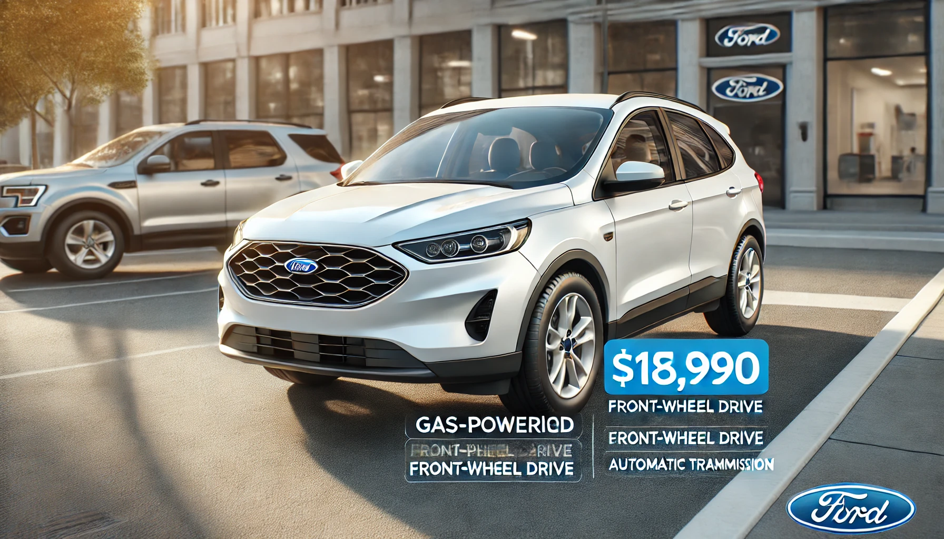
Recommendations
Strategize
Emphasize popular features like white color, gas fuel type, auto transmission and FWD in advertising
Promote Ford or popular brands and 2014-2018 model years to target the majority of consumers
Showcase High-Value Vehicles for a luxury niche.

Slide 19
THANK YOU
Charles Mbakop – Founder
Professional Email
cmbakop301@gmail.com
School Email
cmbakop@student.umgc.edu
www.boost-organic.com

